Slide 1
Microwave Devices E511
Lecture 10
Amr Al.Awamry

Slide 2
Agenda
Lossless Divider
Resistive Divider
Waveguide Directional coupler
Quadrature Hybrids

Slide 3
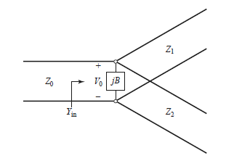
Lossless Divider
The simplest type of power divider is the T junction. T junction can be implemented using virtually any type of transmission line. However, the T junction is very simple to implement, it must be treated with care because it does not offer any isolation between its ports.

Slide 4
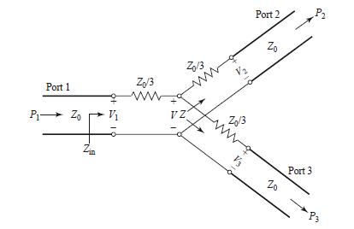
Resistive Divider
The resistive power divider for an equal power split.
If the T junction contains lossy components then it is possible to match all the three ports. In this case the signal power will be reduced due to loss in the junction.

Slide 5
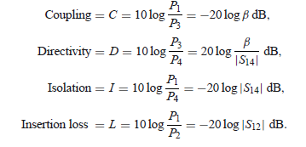
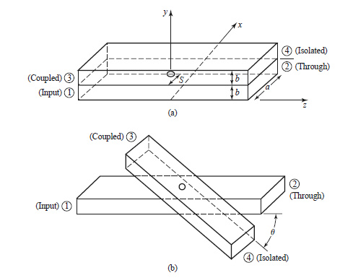
Waveguide Directional coupler

Slide 6
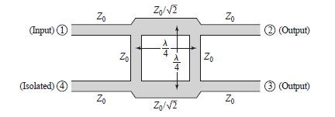
Quadreature Hybrid

